Slide 1
Nuclear Power Plant Fault Detection Device Using IOT
FINAL REVIEW
GuidedBy,
Mrs.Gokila S
Assistant Professor,
Department of Information Technology,
Karpagam Institute of Technology, Coimbatore
Presented by
KEERTHIVASAN.A(721221205021),
LINGESH.L(721221205024),
Department of Information Technology,
Karpagam Institute of Technology,
Coimbatore.

Slide 2
Abstract:
With the advent of recent IoT technologies in Smart Industrial Automation, the need for Automatic Automation Systems (AAS).
The proposed network system incorporates multiple sensors to monitor environmental parameters.
Once harmful attacks occurred in the environment, the sensor node will provide an effective notification and warning mechanism for the users.
A smart IoT gateway is implemented to provide data processing, local server and client connection.

Slide 3
Problem Identification
Inaccurate Fault Detection and High False Positives:
One of the major challenges in automatic fault detection is ensuring that the system accurately identifies real faults without generating false positives. In many industrial environments, sensors can pick up noise.
Data Overload and Processing Delays:
With the large volume of data generated by IoT sensors in real-time, there is a risk of data overload. Industrial systems often involve thousands of sensors, and processing all the data to detect potential faults or abnormalities can result in delay.
Connectivity and Network Reliability Issues:
In IoT-based systems, reliable network connectivity is essential for transmitting sensor data to the cloud for analysis. However, industrial environments often have issues with network reliability due to factors such as interference.

Slide 4
Introduction
Nuclear power plants are very important for producing electricity, but they must be carefully monitored to stay safe. If something goes wrong and a problem is not noticed in time, it can be very dangerous. That’s why fault detection is very important.
This project is about creating a fault detection device using IoT (Internet of Things) technology. We will use sensors to check things like temperature, pressure, and radiation inside the plant. These sensors will send data to a system that watches for anything unusual.
If a problem is found, the system will send an alert so that action can be taken quickly. By using IoT, we can monitor the plant in real-time, from anywhere, and help prevent accidents before they happen.

Slide 5
Existing System:
As an Industrial Control System is a cyber-physical system, the process of security risk propagation in ICSs is different from that in general network systems.
Most ICS failure detection aim to vandalize ICS assets, which include humans, environment, and equipment.
Traditionally, safety monitoring and automation systems were typically designed to meet the requirements of a single monitoring application.

Slide 6
Proposed work:
Temperature and Humidity Monitoring System : Use IoT sensors to monitor temperature and humidity levels in industrial environments.
Vibration-Based Fault Detection in Machines: Attach vibration sensors to machines to detect abnormal vibrations.
Power Consumption and Overload Detection: Measure power usage of industrial equipment using smart energy meters.
Gas Leak and Air Quality Monitoring: Deploy IoT-based gas sensors to detect harmful gas leaks.
Conveyor Belt Fault Detection System: If an issue is detected, the system stops the conveyor automatically.

Slide 7
Project Domain:
Internet of Things (IoT)
Fault Detection Techniques – Various methods of detecting faults in industrial systems, including traditional approaches and modern AI/ML-based methods
Real-Time Data Processing and Analytics– Real-time to identify abnormal conditions and predict possible failures.
IoT-based Remote Monitoring System – The design and working of an IoT-based remote monitoring system for industrial applications.

Slide 8
Technological Stack:
Hardware Domain
Microcontroller
Sensors
Data Processing
Wireless Communication
Remote Monitoring
Software domain
Embedded Software for IoT Devices: This domain focuses on the software required to program IoT devices (e.g., microcontrollers, sensors, and actuators).
2. IoT Communication Protocols and Security Software: The software that has reliable communication between IoT devices, edge systems.

Slide 9
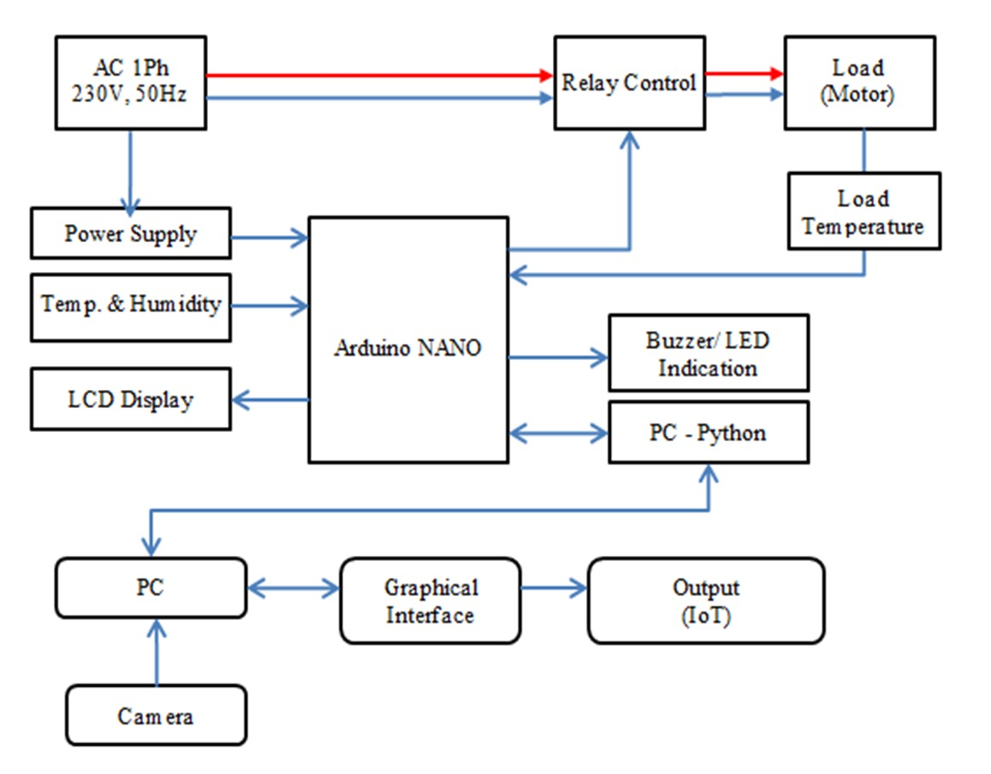
Block Diagram:

Slide 10
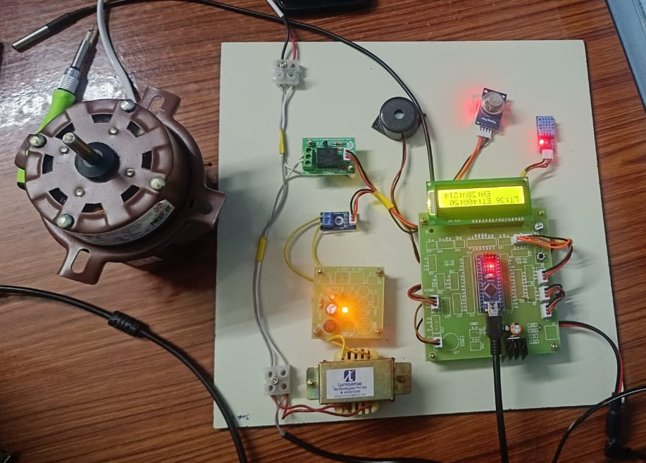
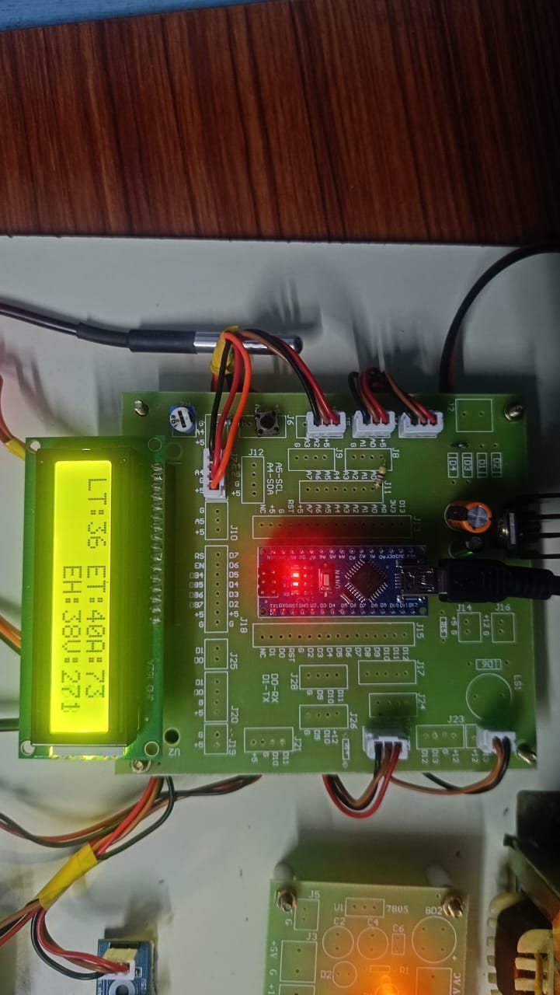
Output
Output : Overload, on, off.

Slide 11
References
S. Kumar, A. Singh, "IoT-Based Predictive Maintenance for Smart Manufacturing," IEEE Internet of Things Journal, 2022.
P. Verma, J. Patel, "Smart IoT Systems for Industrial Automation and Remote Monitoring," International Journal of Scientific Research in Engineering, 2021.
M. Ali, R. Gupta, "AI and ML Techniques for Fault Detection in Industrial IoT," Springer Advances in AI Research, 2023.
S. D., J. S., et al.Published in: Second International Conference on Electronics and Renewable Systems (ICEARS), 2023.
Muhammad Yousuf, Turki Alsuwian, et al.Published in: Measurement and Control, 2023.

Slide 12
Thank You!

